Slide 1
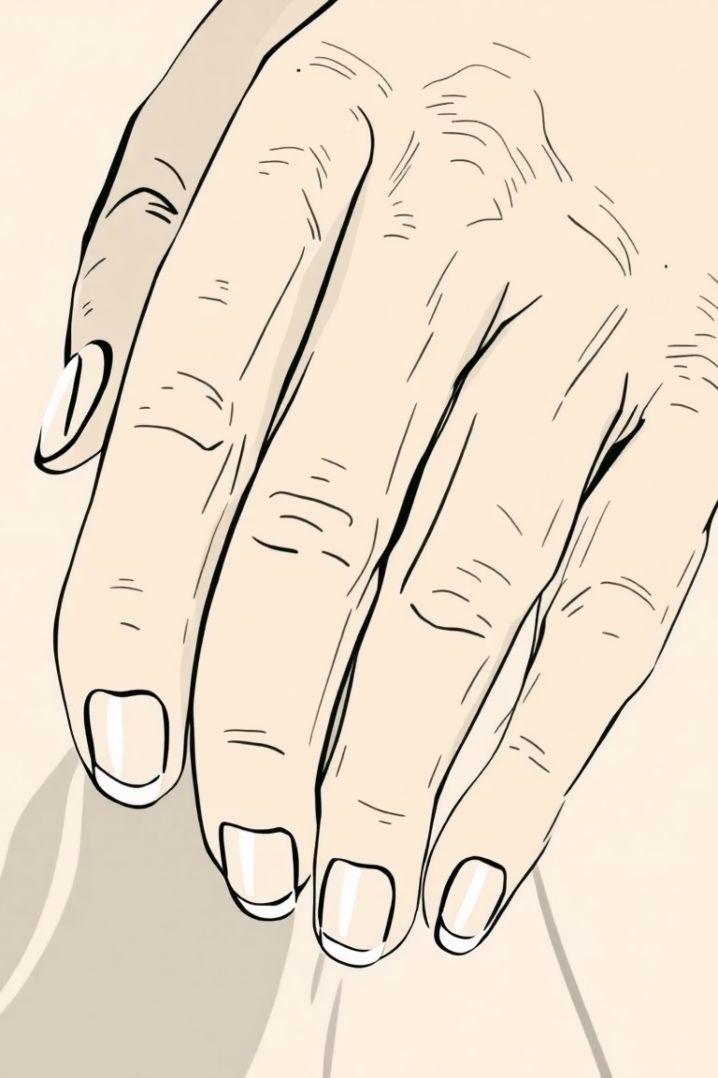

B12Scan: AI-Powered Vitamin B12 Screening
Detect B12 deficiency risk in 10 seconds using only your phone camera
Presented By: BreakingProd Team
Bhavin Padiya Smit Patel
Shreyansh Patel Lokendar Singh

Slide 2
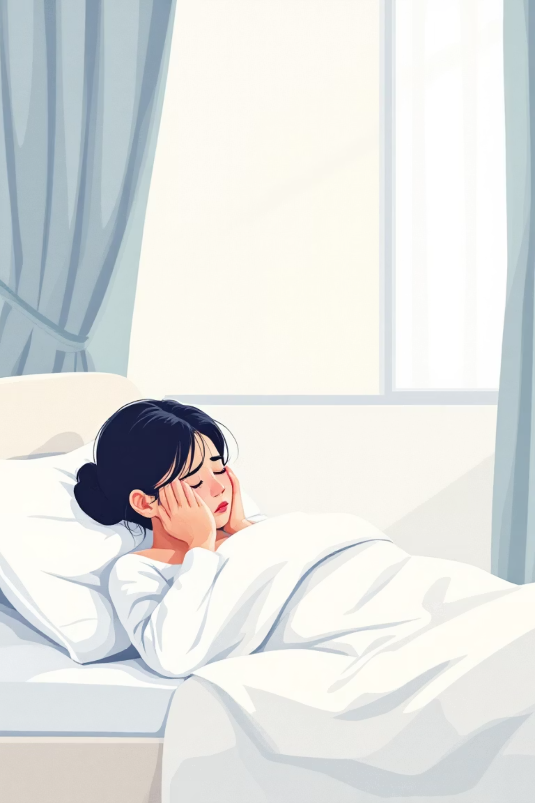
The Silent Epidemic
Vitamin B12 deficiency is widespread and underdiagnosed
1 in 3
Causes fatigue, nerve damage, cognitive decline
Highly prevalent in vegetarian populations
Indians deficient
Blood tests remain expensive, inconvenient
80%
Most delay testing until symptoms worsen
Go undiagnosed

Slide 3
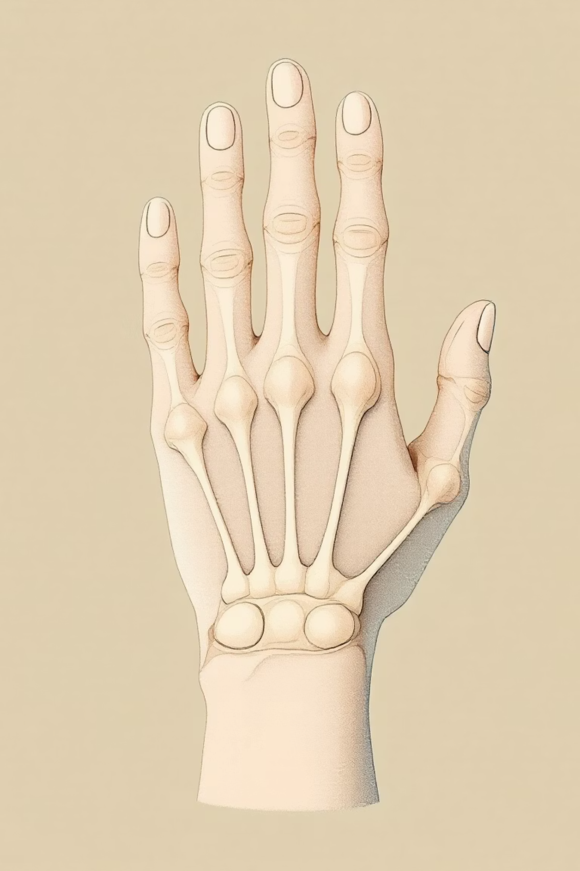
Clinical Foundation:
Karanth's Test
Middle Phalanx
Knuckle
Simple Visual Screening
Clinically Validated
Compares knuckle hyperpigmentation vs flat phalanx shade
Published in JAPI (2015) with promising pilot results
Flat Phalanx
Strong Accuracy
~80% sensitivity, ~84% specificity in initial studies
If knuckle-to-phalanx color difference is significant → possible B12 deficiency

Slide 4

The Biology Behind the Signal
01
B12 deficiency reduces glutathione
02
Lower glutathione increases melanin production
03
Knuckles accumulate pigmentation faster
04
Pattern visible weeks before severe symptoms

Slide 5
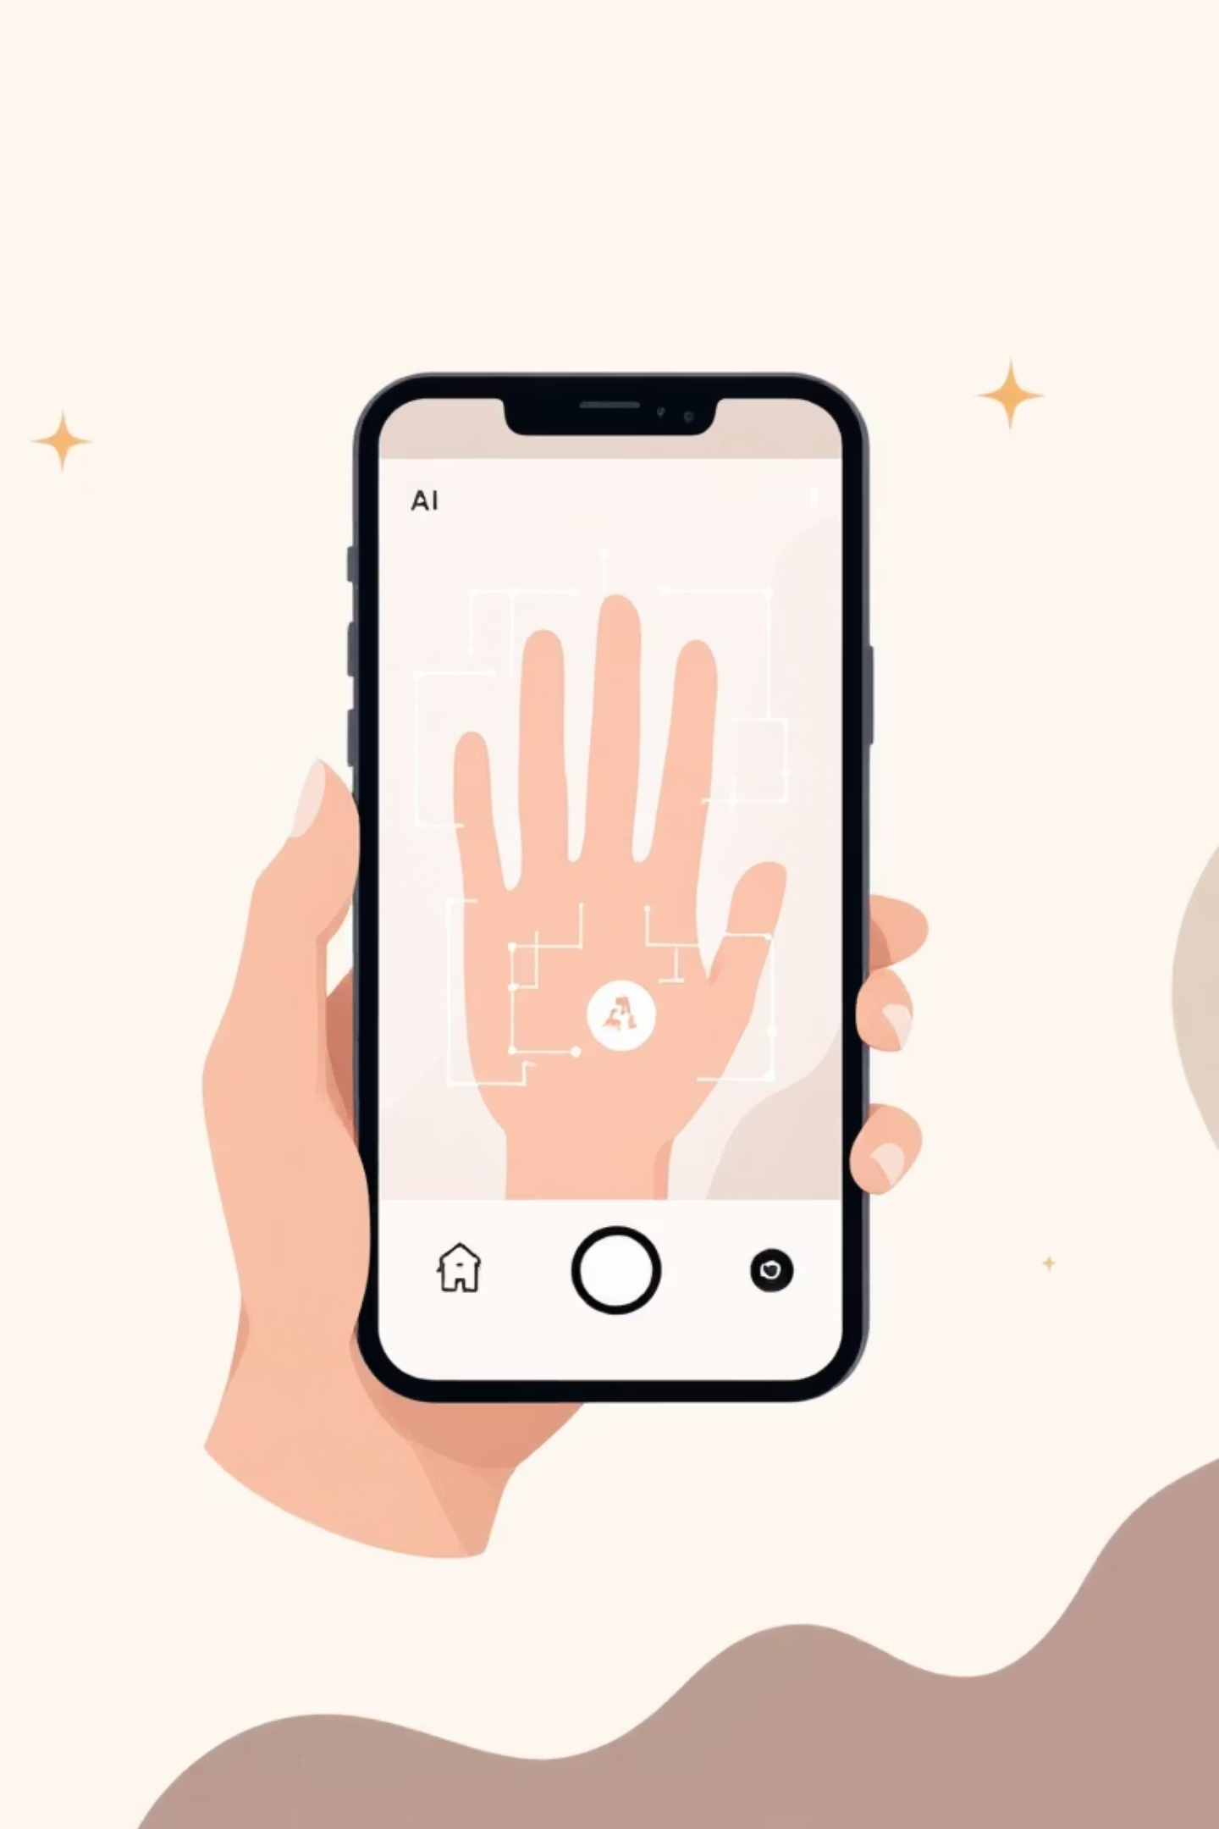



Our Innovation
Camera-based Karanth Test Screening Made Simple
Hand Landmark Detection
Automatic identification of finger joints and skin regions
Precise Color Measurement
Scientific ΔE calculation in CIELAB color space
Risk Assessment
Outputs screening level, not diagnosis—100% non-invasive

Slide 6

How It Works
Camera Capture
User places hand palm-down inside guided frame
AI Detection
MediaPipe Hands identifies finger joints automatically
ROI Extraction
Point A (knuckle) and Point B (phalanx) regions isolated
Color Analysis
RGB converted to CIELAB, ΔE difference computed
Risk Output
Karanth threshold applied: Low / Borderline / Possible Deficiency

Slide 7
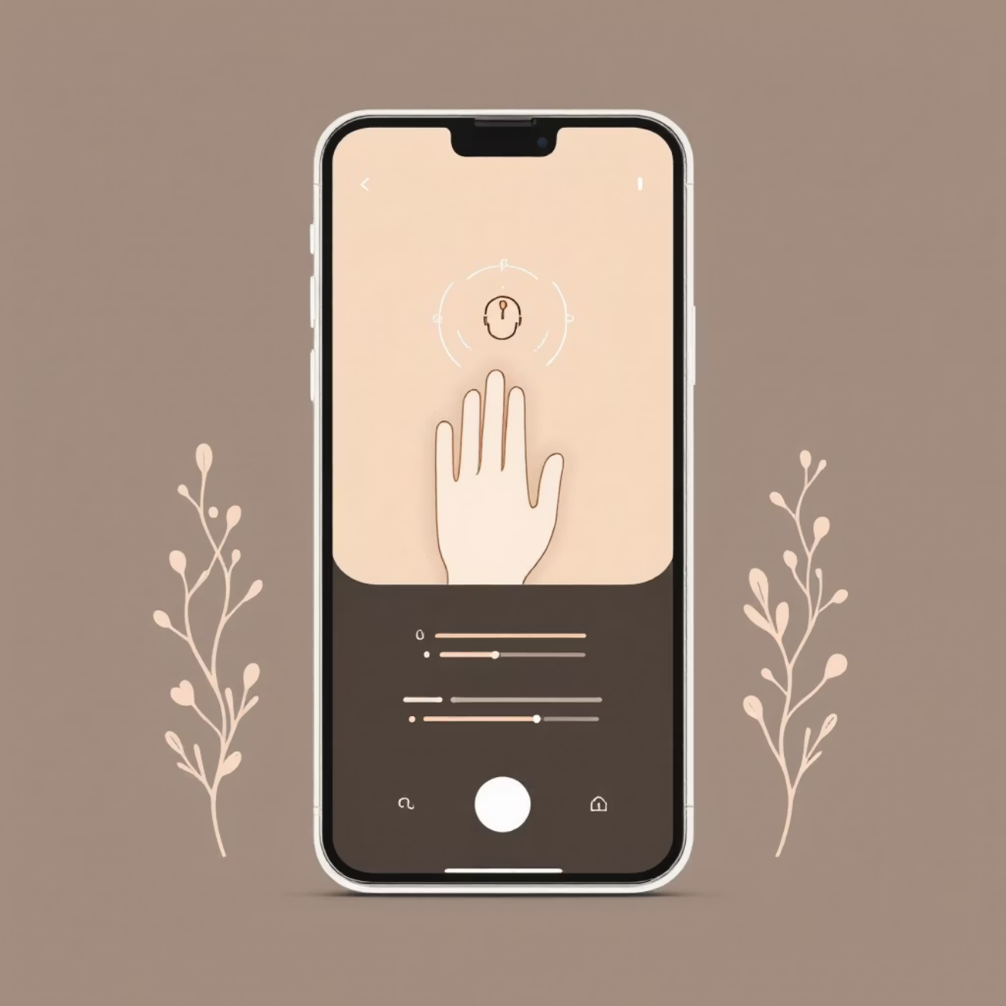


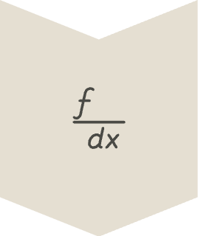

Live Demo: 10-Second Screening
Open web app
Live hand scan
Real-time ΔE calculation
Instant result
Complete screening process from camera open to result in under 10 seconds

Slide 8
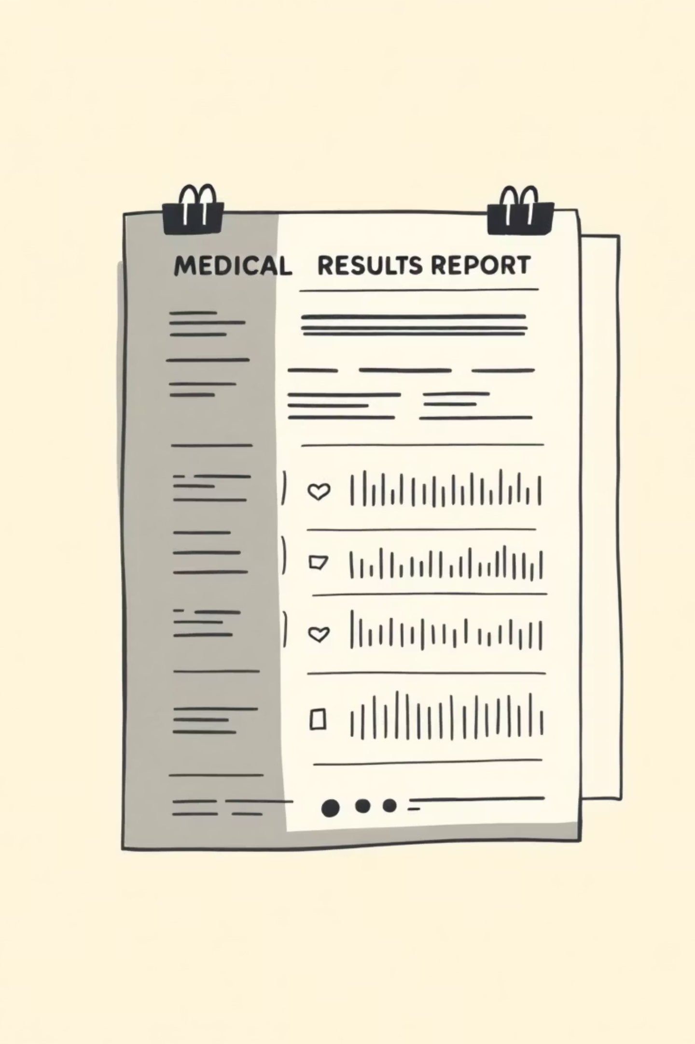
Understanding Your Results
We provide screening risk assessment, not medical diagnosis
Low Risk
Borderline
ΔE ≤ 1.5
1.5 < ΔE ≤ 3
Knuckle pigmentation within normal range
Monitor symptoms, consider dietary adjustment
Possible Deficiency
ΔE > 3
Recommend serum B12 blood test

Slide 9
Behind the Scene
Flask API
Temporary storage
Handles file uploads, validation, processing, and response generation.
Used for local file handling → cleaned immediately after upload to MinIO.
MediaPipe
Local Storage
Used for hand detection, landmark extraction, and orientation correction.
Used as a local file storage system for handling temporary uploads and processed images.
OpenCV + NumPy
used for ROI extraction, color analysis, K-means clustering and HSV comparison.

Slide 10
Steps after User Uploads an Image
Image Validation & Preprocessing
Color & Shade Evaluation
Ensures the uploaded file is a valid hand image so the system can analyze it properly.
Uses OpenCV to compare skin shades between these two regions — this is the core logic behind Karanth’s screening approach.
Hand & Finger Detection
Vitamin B12 Status Estimation
We use MediaPipe because it gives highly accurate hand landmark detection, allowing us to consistently identify the index finger.
Based on the shade difference, the system predicts whether the user is more likely to have a normal or deficient status.
Identifying Key Finger Regions
Result Generation
The system isolates two areas on the index finger that are clinically relevant for Vitamin B12 screening.
Creates an annotated output image highlighting the analyzed areas and returns a clear, simple summary to the user.

Slide 11
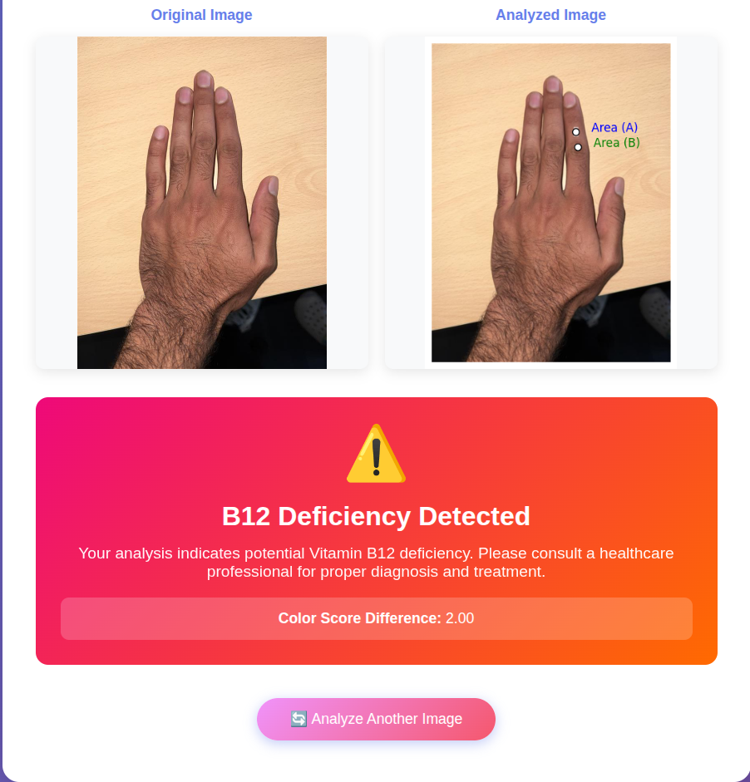
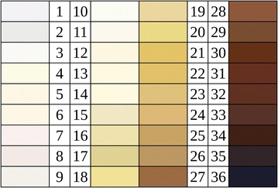
Before and After Visuals
Von Luschan skin tone chart

Slide 12

Future Improvements
Detailed Health Report Generation
Instant Risk Assessment Summary
Lifestyle & Diet Recommendation Module
Interactive Finger Position Guide

Slide 13
Thank You!!

